Slide 1




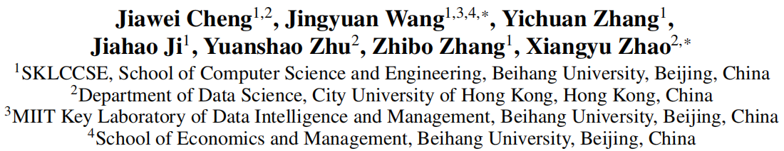





ATAI
Advanced Technique of Artificial Intelligence
ATAI
ChongqingUniversity _{AdvancedTechniqueof}
of Technology Artificial Intelligence
Chongqing University of
Technology
Chongqing University ^{ATAI}
_{of Technology} Advanced Techniqueof
Artificial Intelligence
Chongqing University of Technology
Chongqing University of Technology
POI-Enhancer: An LLM-based Semantic Enhancement Framework
for POI Representation Learning
Code:https://github.com/Applied-Machine-Learning-Lab/POI-Enhancer
——AAAI_2025
Reported by Long Zhang
1

Slide 2
ATAI
Advanced Technique of Artificial Intelligence
ATAI
ChongqingUniversity _{AdvancedTechniqueof}
of Technology Artificial Intelligence
Chongqing University of
Technology
Chongqing University ^{ATAI}
_{of Technology} Advanced Techniqueof
Artificial Intelligence
Chongqing University of Technology
Chongqing University of Technology
Motivation
Research background: Previously, the textual information incorporated into POI representations typically involved only POI categories or check-in content, leading to relatively weak textual features in existing methods. In contrast, large language models (LLMs) trained on extensive text data have been found to possess rich textual knowledge.
Facing two key challenges:
1) The first challenge lies in effectively extracting the geographical knowledge within LLMs.
Avoid single tasks and implement universal vectors across tasks
2)The second challenge is how to effectively integrate the extracted textual information into POI representation for enhancement.
Avoid ignoring feature interactions

Slide 3
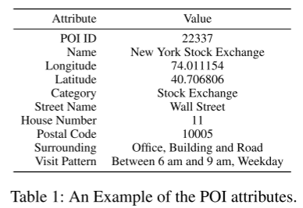
ATAI
Advanced Technique of Artificial Intelligence
ATAI
ChongqingUniversity _{AdvancedTechniqueof}
of Technology Artificial Intelligence
Chongqing University of
Technology
Chongqing University ^{ATAI}
_{of Technology} Advanced Techniqueof
Artificial Intelligence
Chongqing University of Technology
Chongqing University of Technology
POI: p = ( id, pn, c, lon, lat, ...)
check-in record: r = ( u ,p ,t )
Check-in Record Sequence: R =[r1, r2, ... rL] order: t
the set of all users’ check-in record sequences: S=[ R1, R2, ... ]
Epi = f(pi) for each POI
Epi = g( F(pi) ), Epi∈ Rd, where d is a uniform dimension.

Slide 4
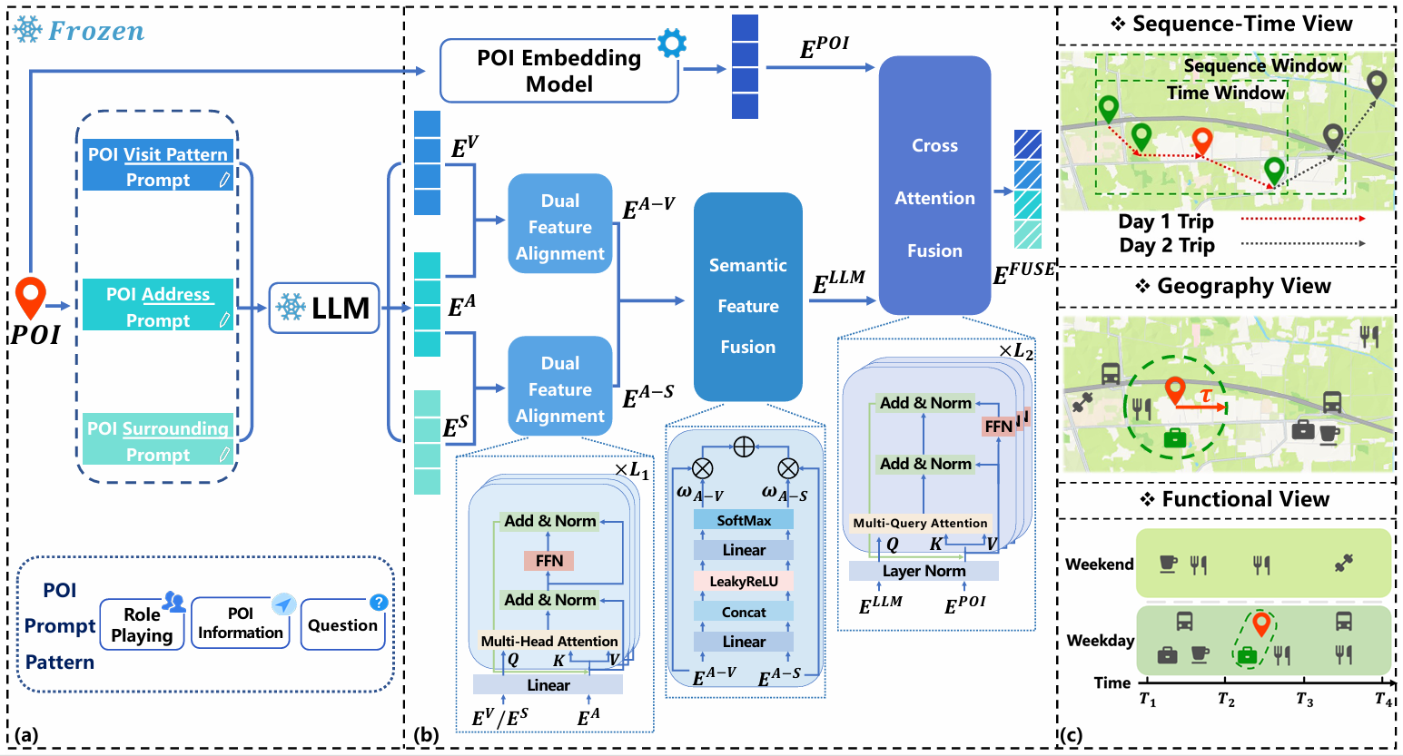
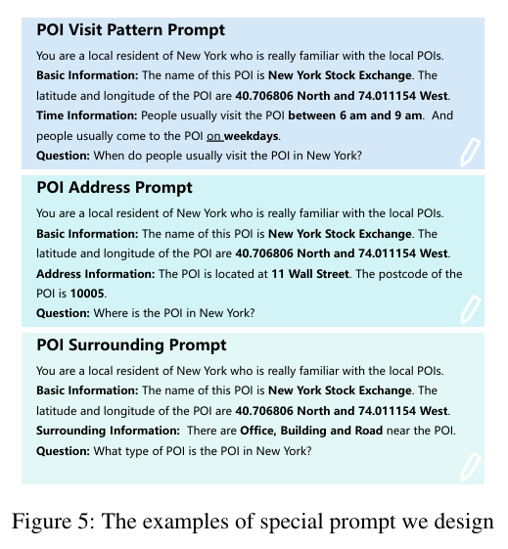
ATAI
Advanced Technique of Artificial Intelligence
ATAI
ChongqingUniversity _{AdvancedTechniqueof}
of Technology Artificial Intelligence
Chongqing University of
Technology
Chongqing University ^{ATAI}
_{of Technology} Advanced Techniqueof
Artificial Intelligence
Chongqing University of Technology
Chongqing University of Technology
Method

Slide 5
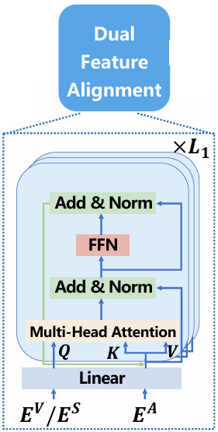
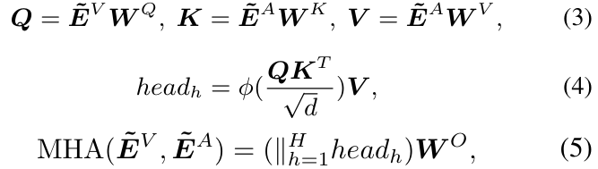
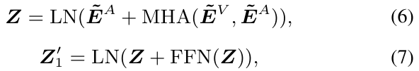
ATAI
Advanced Technique of Artificial Intelligence
ATAI
ChongqingUniversity _{AdvancedTechniqueof}
of Technology Artificial Intelligence
Chongqing University of
Technology
Chongqing University ^{ATAI}
_{of Technology} Advanced Techniqueof
Artificial Intelligence
Chongqing University of Technology
Chongqing University of Technology
Method

Slide 6
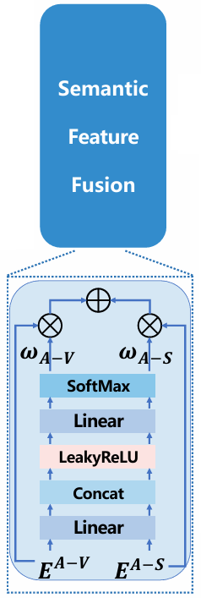


ATAI
Advanced Technique of Artificial Intelligence
ATAI
ChongqingUniversity _{AdvancedTechniqueof}
of Technology Artificial Intelligence
Chongqing University of
Technology
Chongqing University ^{ATAI}
_{of Technology} Advanced Techniqueof
Artificial Intelligence
Chongqing University of Technology
Chongqing University of Technology
Method

Slide 7
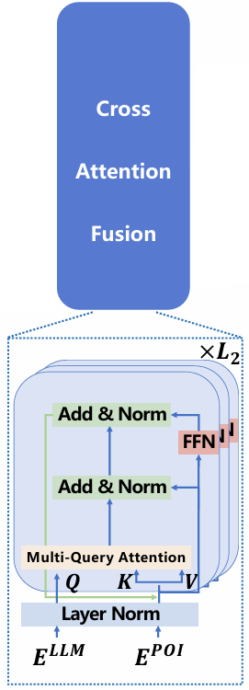


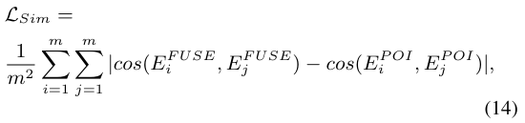
ATAI
Advanced Technique of Artificial Intelligence
ATAI
ChongqingUniversity _{AdvancedTechniqueof}
of Technology Artificial Intelligence
Chongqing University of
Technology
Chongqing University ^{ATAI}
_{of Technology} Advanced Techniqueof
Artificial Intelligence
Chongqing University of Technology
Chongqing University of Technology
Method

Slide 8
ATAI
Advanced Technique of Artificial Intelligence
ATAI
ChongqingUniversity _{AdvancedTechniqueof}
of Technology Artificial Intelligence
Chongqing University of
Technology
Chongqing University ^{ATAI}
_{of Technology} Advanced Techniqueof
Artificial Intelligence
Chongqing University of Technology
Chongqing University of Technology
Method
Sequence-Time Contrastive Learning A formal constraintis that given a check-in record sequence R and a check-in record r = (u, p, t), for any r′ = (u, p′, t′) in the R, wehave the following two requirements for r′:
• |index(r′) − index(r)| ≤ λ, where index is a function indicating the position in R, and λ is a threshold.
• date(r′) = date(r), where date is a function that extracts the date from a timestamp.
The p′ in r′ which meets the above requirements is considered a positive sample.
Geography Contrastive Learning Given a POI p, the positive samples p′ have to meet the following two criteria:
• Area(p) is defined as Square(p, τ), where Square is a function that generates the corresponding square region with a side length of τ. The point p′ lies within theArea(p).
• p′.c = p.c, and c is the category attribute of a POI introduced in Section 2.
Functional Contrastive Learning Given a POI p, the positive samples p′ must satisfy the following two conditions:
• p′.visit pattern = p.visit pattern, and visit pattern is the visit pattern attribute of a POI.
• p′.c = p.c, where c is the category attribute of a POI.

Slide 9
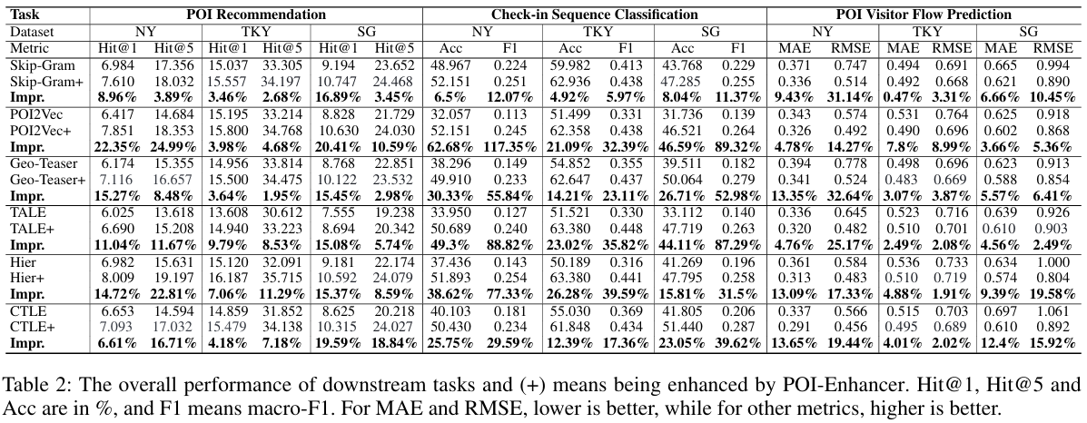
ATAI
Advanced Technique of Artificial Intelligence
ATAI
ChongqingUniversity _{AdvancedTechniqueof}
of Technology Artificial Intelligence
Chongqing University of
Technology
Chongqing University ^{ATAI}
_{of Technology} Advanced Techniqueof
Artificial Intelligence
Chongqing University of Technology
Chongqing University of Technology
Experiments

Slide 10
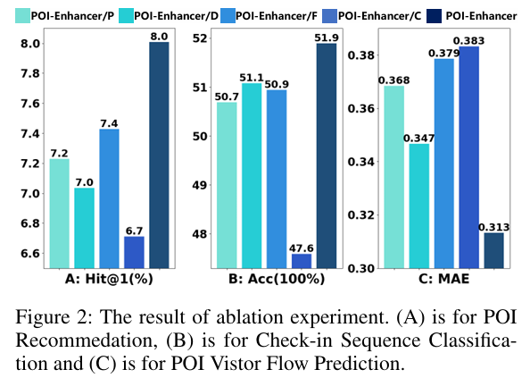
ATAI
Advanced Technique of Artificial Intelligence
ATAI
ChongqingUniversity _{AdvancedTechniqueof}
of Technology Artificial Intelligence
Chongqing University of
Technology
Chongqing University ^{ATAI}
_{of Technology} Advanced Techniqueof
Artificial Intelligence
Chongqing University of Technology
Chongqing University of Technology
Experiments

Slide 11

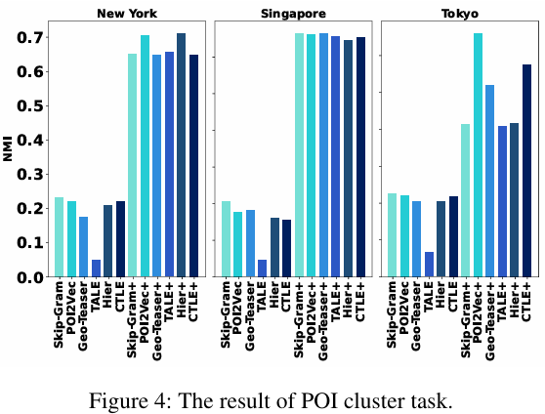
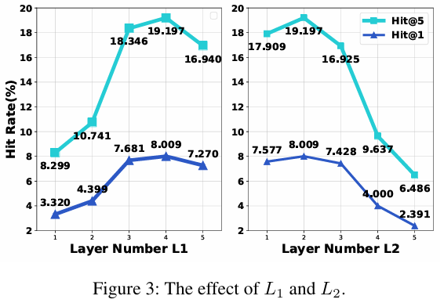
ATAI
Advanced Technique of Artificial Intelligence
ATAI
ChongqingUniversity _{AdvancedTechniqueof}
of Technology Artificial Intelligence
Chongqing University of
Technology
Chongqing University ^{ATAI}
_{of Technology} Advanced Techniqueof
Artificial Intelligence
Chongqing University of Technology
Chongqing University of Technology

Slide 12
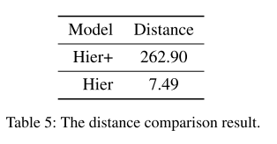
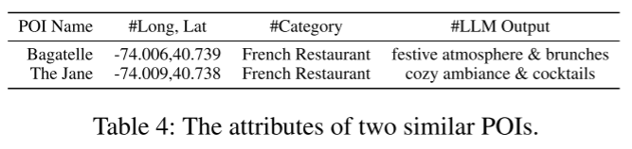
ATAI
Advanced Technique of Artificial Intelligence
ATAI
ChongqingUniversity _{AdvancedTechniqueof}
of Technology Artificial Intelligence
Chongqing University of
Technology
Chongqing University ^{ATAI}
_{of Technology} Advanced Techniqueof
Artificial Intelligence
Chongqing University of Technology
Chongqing University of Technology

Slide 13


ATAI
Advanced Technique of Artificial Intelligence
ATAI
ChongqingUniversity _{AdvancedTechniqueof}
of Technology Artificial Intelligence
Chongqing University of
Technology
Chongqing University ^{ATAI}
_{of Technology} Advanced Techniqueof
Artificial Intelligence
Chongqing University of Technology
Chongqing University of Technology
Thanks!

